Slide 1

DSA0613- Data Handling and Visualization for Data Analytics
CAPSTONE PROJECT
ON
Integrating Advanced Data Visualization using R Programming for Business Demand Forecasting
GUIDED BY
DR.KUMARAGURBARAN
(DEPARTMENT OF COMPUTER SCIENCE)
DR.S.SENTHILVADIVU
(DEPARTMENT OF COMPUTER SCIENCE )
SUBMITTED BY: P.SWATHIKA(192324197)
R.PARAMESWARI(192324118)

Slide 2
ABSTRACT
This project applies R programming and data visualization to analyze sales and customer review data for business intelligence.
Module 1 focuses on demand and price forecasting by identifying trends and seasonal patterns using time-series visualizations and models like Random Forest and XGBoost
.Module 2 performs sentiment analysis and topic modeling on customer reviews to validate ratings and understand customer perceptions.
The integrated insights support better inventory management, pricing decisions, and strategic business planning.

Slide 3
INTRODUCTION
In today’s data-driven e-commerce environment, businesses generate massive volumes of sales and customer feedback data.
Platforms like Amazon produce complex datasets containing pricing, ratings, discounts, and customer reviews
Traditional analysis methods fail to capture hidden patterns such as seasonality, sentiment impact, and price sensitivity.
This project uses R programming to transform raw Amazon data into actionable business insights.

Slide 4
PROBLEM STATEMENT
Businesses face uncertainty in predicting future demand and pricing trends.
Customer ratings may not always reflect true sentiment due to fake or biased reviews.
Isolated analysis of sales or reviews leads to incomplete decision-making.
There is a need for an integrated analytical framework combining forecasting and sentiment validation.

Slide 5
OBJECTIVES OF THE PROJECT
To forecast product demand and price trends using advanced models.
To compare Random Forest and XGBoost forecasting accuracy.
To analyze customer review sentiment using VADER.
To detect mismatches between star ratings and textual sentiment.
To visualize insights using professional R-based plots and dashboards.

Slide 6
SIGNIFICANCE OF THE STUDY
Helps businesses make data-driven inventory decisions.
Improves pricing strategies through feature importance analysis.
Enhances trust in customer feedback by identifying suspicious reviews.
Bridges the gap between quantitative data and qualitative insights.
Demonstrates the real-world power of R for business intelligence.

Slide 7
SCOPE OF THE PROJECT
Uses publicly available Amazon sales and review datasets.
Focuses on structured sales data and unstructured text reviews.
Includes forecasting, sentiment analysis, and visualization.
Limited to selected product categories and time range.
Does not include real-time data or live deployment.

Slide 8
OVERALL METHODOLOGY
The project follows a two-module approach.
Module 1: Demand and price forecasting.
Module 2: Sentiment and review authenticity analysis.
Data cleaning, modeling, evaluation, and visualization are performed entirely in R.
Results are integrated for holistic business interpretation.

Slide 9
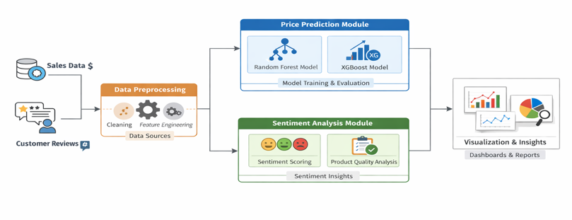
SYSTEM ARCHITECTURE

Slide 10
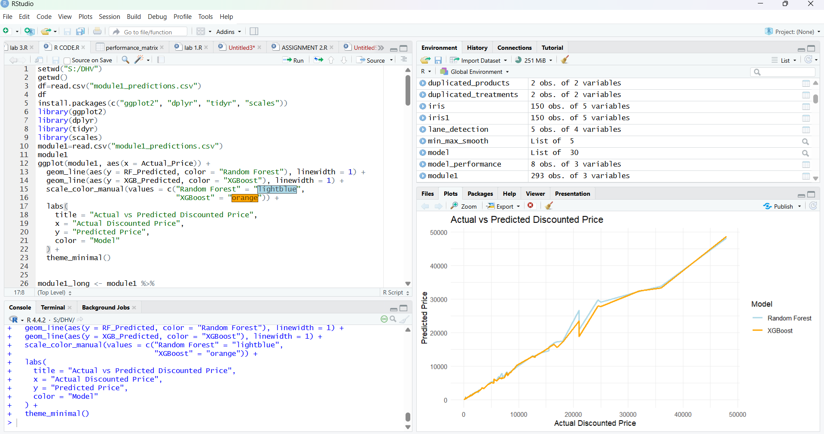
TOOLS AND TECHNOLOGIES
Programming Language: R
IDE: RStudio
Libraries:
tidyverse
ggplot2
Random Forest
xgboost
tidytext
topicmodels
Reporting: R Markdown

Slide 11
Module 1: Price Demand Forecasting using machine learning models and data visualization
Random Forest
Handles seasonality and trend changes effectively.
Suitable for business time-series data.
XGBoost Model
Gradient boosting algorithm.
Captures complex relationships between price, discounts, and ratings.
Historical sales and price data are cleaned and prepared.
Forecasting models are trained and tested.
Outputs include predicted prices, trends, and error metrics.

Slide 12
MODEL EVALUATION METRICS &RESULTS
RMSE (Root Mean Square Error)
MAE (Mean Absolute Error)
MAPE (Mean Absolute Percentage Error)
Used to compare accuracy between models.
Helps in selecting the best forecasting approach.
Random Forest performed better for forecasting.
XGBoost revealed key drivers like discount percentage and rating count.
Visualizations clearly showed seasonal patterns and prediction accuracy.
Results support better pricing and inventory decisions.

Slide 13
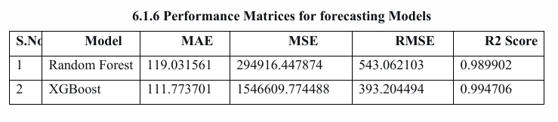
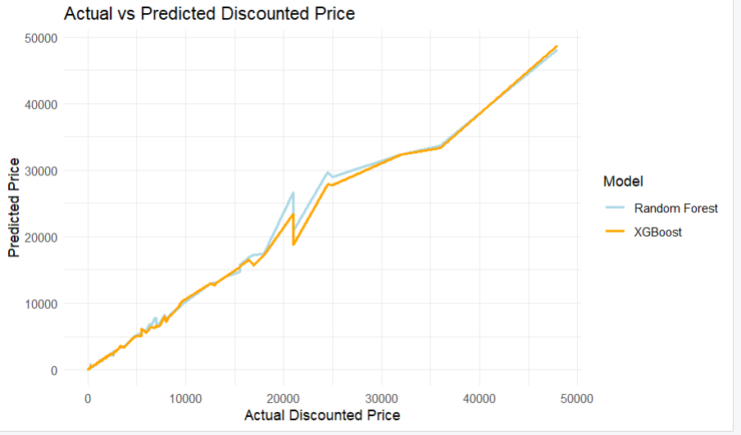
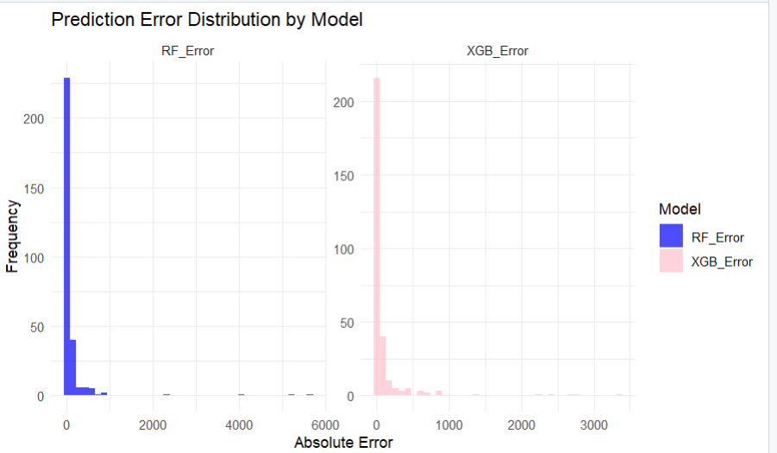
OUTPUTS

Slide 14
Module 2: Sentiment and Thematic Analysis for Review Authenticity Validation
Customer reviews are collected and cleaned.
Text preprocessing includes tokenization and stop-word removal.
Sentiment scores are generated using VADER.
Topics are extracted using LDA.

Slide 15
SENTIMENT ANALYSIS USING VADER &TOPIC MODELING USING LDA
VADER assigns sentiment polarity scores to reviews.
Reviews are classified as positive, neutral, or negative.
Sentiment scores are compared with star ratings.
Mismatches indicate potentially unreliable reviews.
LDA identifies hidden themes in customer reviews.
Common topics include:
Battery Life
Value for Money
Shipping Experience
Helps businesses understand key customer concerns.

Slide 16
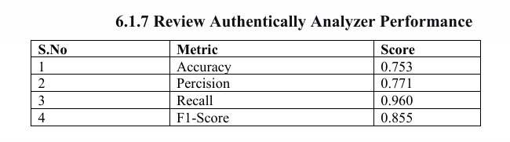
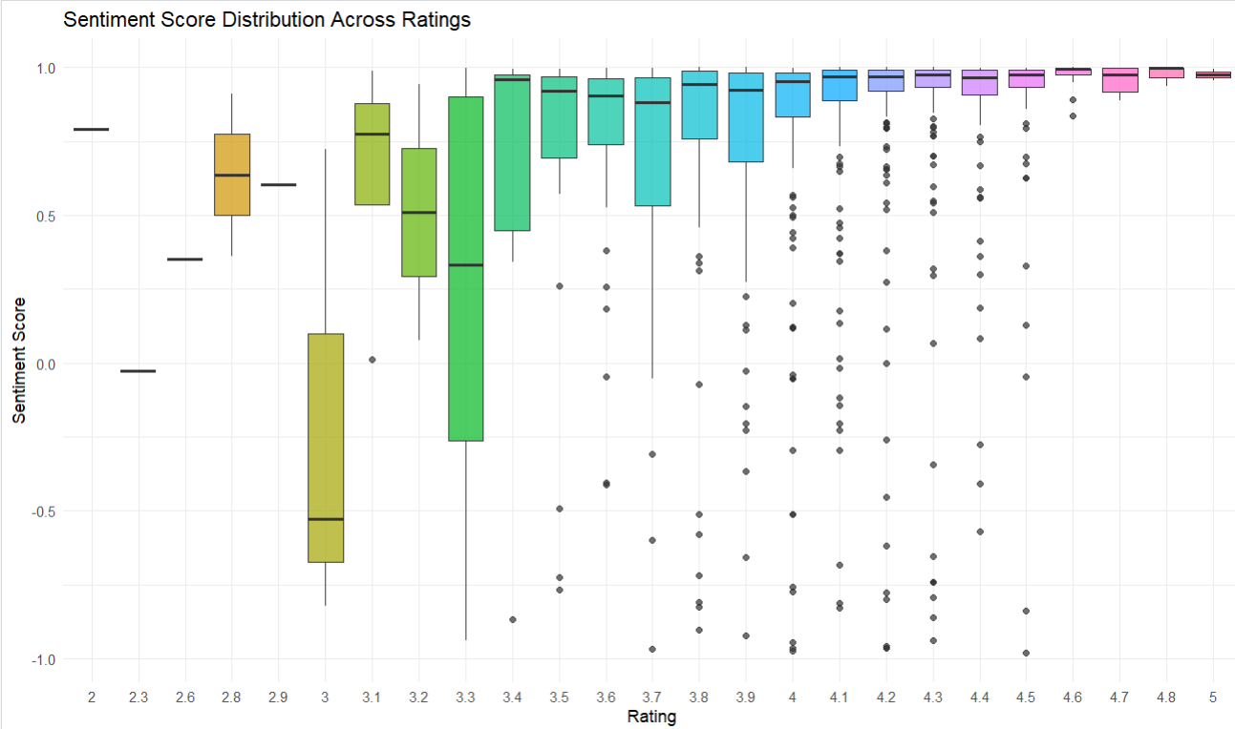
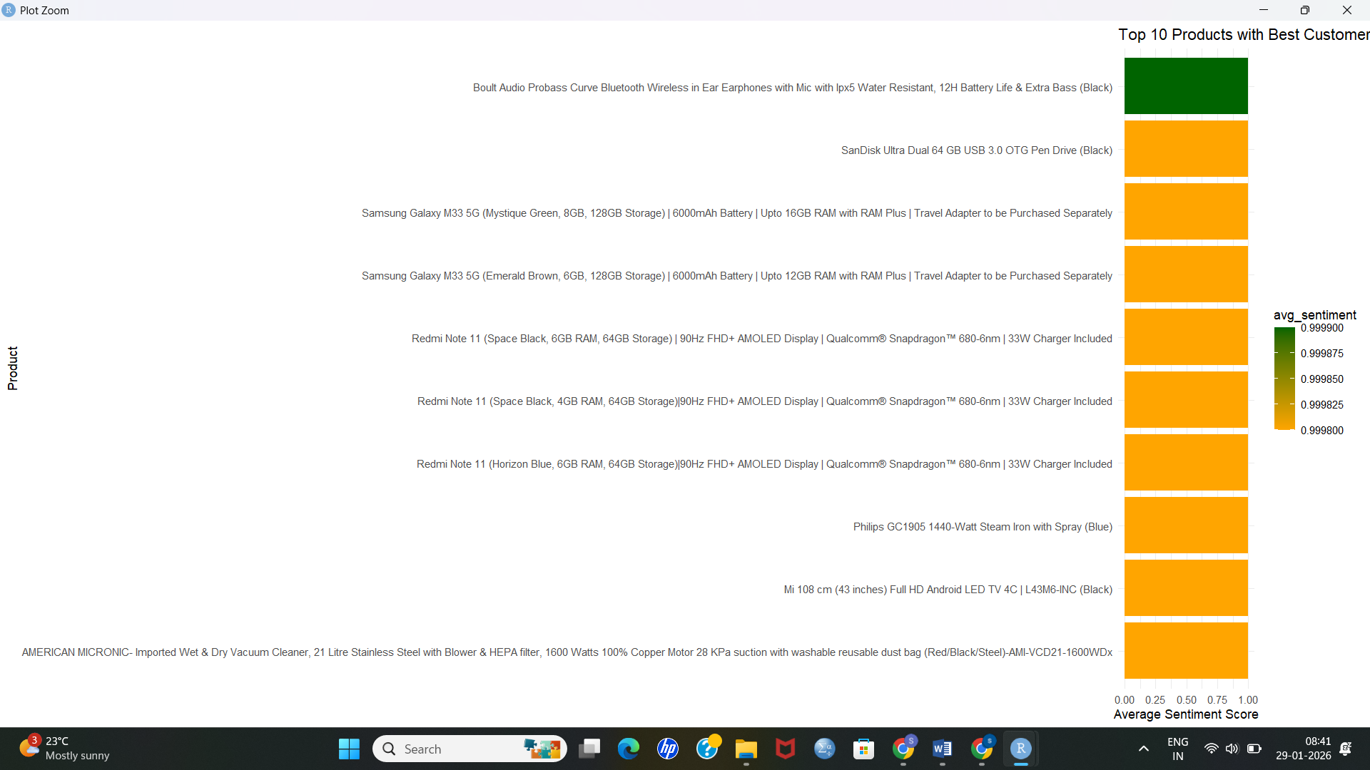
OUTPUTS

Slide 17
LEARNING OUTCOMES
Strong understanding of forecasting and NLP.
Hands-on experience with R analytics pipelines.
Improved problem-solving and critical thinking.
Learned reproducible and ethical data science practices.

Slide 18
CONCLUSION
Successfully integrated forecasting and sentiment analysis.
Delivered meaningful business insights using R.
Demonstrated power of data visualization.
Created a scalable analytics framework for e-commerce.

Slide 19


